Slide 1

“Credit-Card Fraud Detection with Isolation Forest”
ARTIFICIAL INTELLIGIENT
ÖMER FARUK GÜNEŞ

Slide 2
WHAT IS THE PROBLEM?
Only 0.17 % of credit-card transactions are fraudulent.
High volume + tiny anomaly rate → manual detection is impossible.
False negatives (missed fraud) = direct financial loss.
False positives (wrong alarms) = customer frustration and extra costs.

Slide 3
“Dataset: Credit-Card Transactions (Kaggle 2013)”
Rows & Features: 284 807 transactions × 30 PCA-compressed features + Time + Amount.
Label: Class (0 = legit, 1 = fraud).
Class Imbalance: 492 frauds → 0.17 % of the data.
Pre-processing: Time & Amount standardized; PCA features already scaled.
Train / Test Split: 80 % train, 20 % test, stratified by label.

Slide 4
Challenge: Extreme Class Imbalance & “Accuracy Trap”
• Majority class = 99.83 % legit.
• Accuracy is useless here → focus on Recall & Precision.
• Key metrics for fraud class (1) ‣ Recall (TP / TP+FN) ‣ Precision (TP / TP+FP) ‣ F1 = harmonic mean
• Goal chosen: Recall ≥ 50 % with Precision ≈ 12 % (after tuning).

Slide 5
Method Selection: Why Isolation Forest?
Visible bullets (on slide)
• Unsupervised anomaly detector – learns the “normal” pattern, no labels needed
• Works well with extreme imbalance
• Tree-based → non-linear, no need for feature scaling
• Fast: O(n log n) – 300 trees, 284 k rows < 10 s on laptop
• Simple knob: contamination + decision score percentile
(Optional) • Explainable intuition – shorter paths ⇒ anomalies

Slide 6
Model Tuning & Hyper-parameters
Target Balance
Recall ≥ 50% → Cuts missed fraud transactions in half
Precision ≈ 12% → 1 in 8 alerts is real; analyst load is reasonable
Contamination | 99.0 % | 99.3 % | 99.5 %
0.003 | Recall 0.58 / Prec 0.10 | Recall 0.51 / Prec 0.13 | Recall 0.43 / Prec 0.15
0.005 | similar pattern

Slide 7
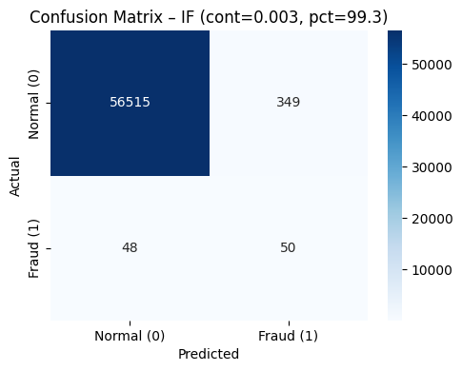
Confusion Matrix: How the Model Performs
Heat-map image of the 2 × 2 confusion matrix
TN 56 515 · FP 349
FN 48 · TP 50
Key numbers right next to the heat-map
• Recall = 51 %
• Precision = 12.5 %
• F1 = 0.20
Small caption: Test set = 56 962 rows (20 % split)

Slide 8
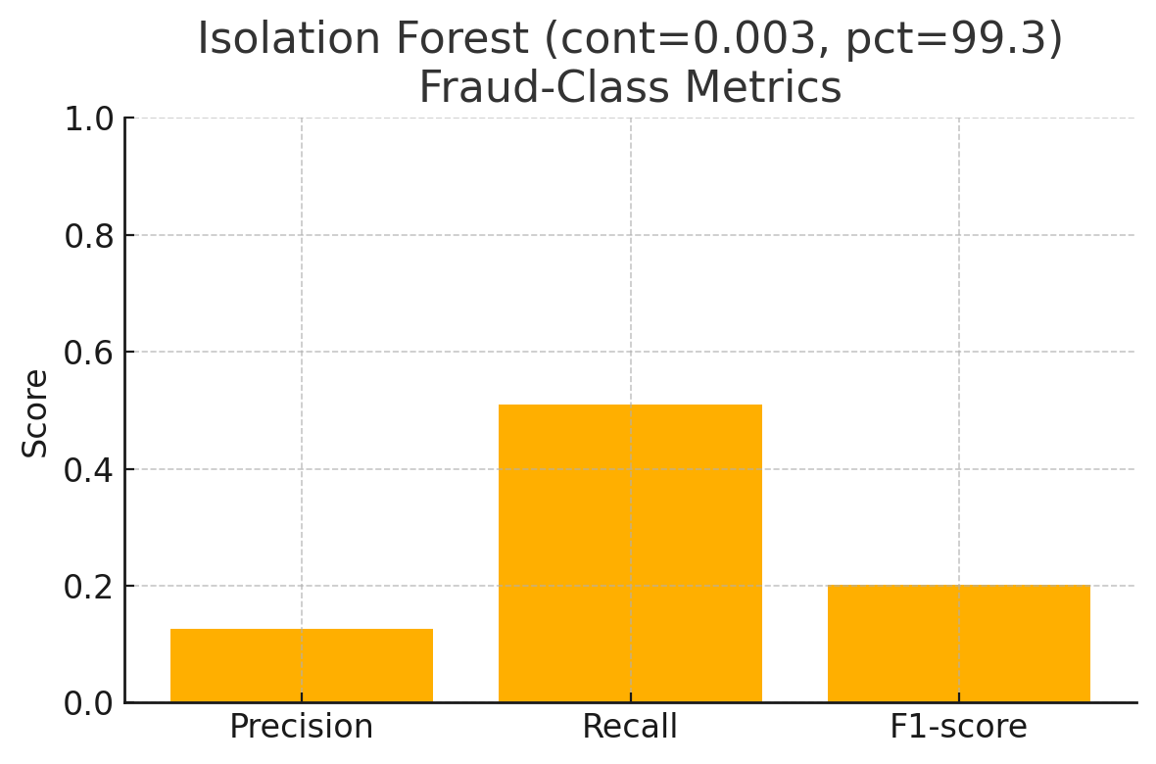
Fraud-Class Metrics
Metric | Score
Recall | 51 %
Precision | 12.5 %
F1-score | 0.20
Support | 98 frauds
Bar chart (already generated)
X-axis: Precision · Recall · F1 Y-axis: 0 – 1
– Precision ≈ 0.13
– Recall ≈ 0.51
– F1-score ≈ 0.20

Slide 9
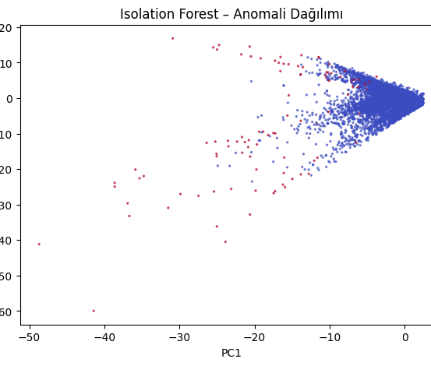
Visual Insight: Where the Anomalies Sit
X-axis = PC 1 Y-axis = PC 2
Red (1) = transactions the model flagged as fraud
Blue (0) = transactions the model left as legit
Caption: “2-D PCA projection · cont 0.003 · threshold 99.3 %”
“Flagged points cluster at the sparse edges of the data cloud.”

Slide 10

Conclusion & Key Take-Away
Unsupervised wins: No labels, still 51 % fraud recall
Operational fit: ≈ 8 alerts → 1 real fraud (12 % precision)
Lightweight: 300 trees · 10 s training · near-real-time scoring
Simple tuning knob: Threshold can move with risk appetite
Bottom-line: Isolation Forest reduces undiscovered fraud by ~50 % with an alert load analysts can handle.

